Slide 1
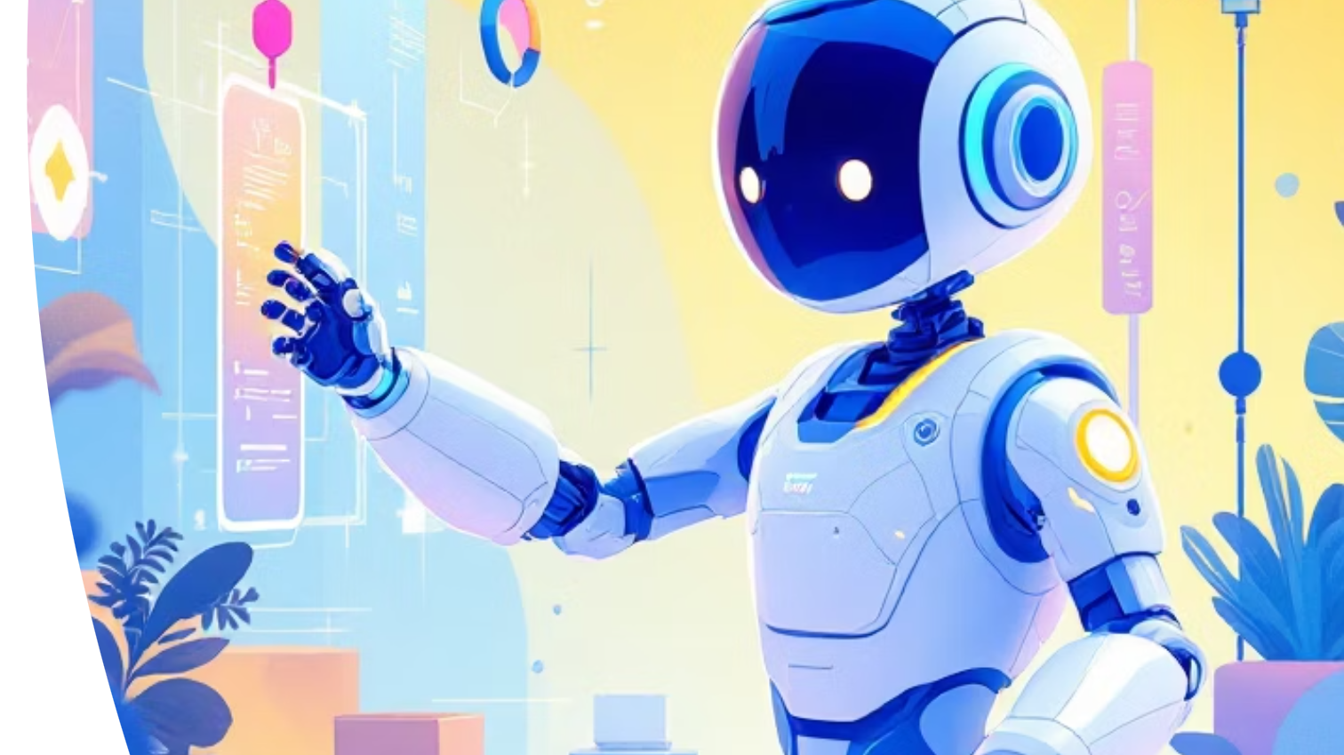
Agentic AI: The Future of Autonomous Intelligence
From Prompt-Based AI to Goal-Driven Systems
Tejaswi B

Slide 2
Why AGENTIC AI?
Increasing System Complexity
Limits of Prompt‑Based & Rule‑Based Automation
Need for Outcome‑Driven Automation
Faster Decision‑Making at Scale
Modern enterprise systems span multiple tools, platforms, and workflows- manual coordination no longer scales.
Traditional AI and automation require constant instructions and break in dynamic, unpredictable scenarios.
Businesses need systems that can work toward goals, not just execute predefined steps.
Human‑in‑the‑loop everywhere slows response times; autonomous agents help operate at machine speed.

Slide 3
What is Agentic AI?
AI systems that can independently plan, decide, and act to achieve a goal -
without constant human prompting.
Digital Team Member
Goal-Driven
Proactive
Makes decisions instead of waiting for instructions
Understands what needs to be achieved, not just what to respond to
Initiates actions and completes multi‑step workflows on its own
Self-Improving
Learns from feedback and improves over time

Slide 4
Core Components
Perception
Cognition
Memory
Action
Learning
Governance
Each component plays a distinct role — together, they enable autonomous, goal‑driven behavior rather than simple prompt‑response interactions.

Slide 5
Traditional AI vs Agentic AI
Traditional AI
"What should I do next?"
Reactive responses
Agentic AI
"Let me figure out how to accomplish this goal"
Proactive operation
Single-step tasks
Requires prompts
Multi-step workflows
Autonomous execution

Slide 6
Technical architecture
User Interface
AI Agent Core
Planning Module
Reasoning & Decision Making
Tool & API Integration
Automation Tools External APIs Databases
Input Processing:
Natural Language Processing
Context Analysis
Data Retrieval
Memory & Knowledgebase
Agent Orchestrator
Action Execution Engine
Feedback & Learning
Reinforcement Learning
Self-Improvement
Experience Updates
Environment Interaction
Web Services IoT Devices Robotic Systems
Monitoring & Security
Logging & Analytics
Access Control
Safety Protocols

Slide 7
Real-World Applications
Automated Customer Service
Software Development
Intelligent agents handle complex customer inquiries, resolve issues, and escalate when necessary—all while learning from each interaction.
Works autonomously toward defined objectives without constant prompting
E-Commerce Operations
Healthcare Coordination
Manages inventory, processes orders, handles payments, and optimizes pricing strategies in real-time across multiple platforms.
Schedules appointments, manages patient records,
analyzes medical data, and assists with diagnosis
recommendations.

Slide 8
Popular Frameworks & Tools
LangChain
Comprehensive framework for building LLM applications with agents
AutoGen
Multi-agent conversation framework by Microsoft
CrewAI
Framework for orchestrating role-playing autonomous AI agents
LlamaIndex
Data framework for LLM applications with agent capabilities

Slide 9
Agentic AI – Accenture Use Cases
Autonomous IT Operations (AIOps)
AI agents monitor systems, detect issues, and trigger remediation with minimal human intervention.
Agentic Process Automation
End‑to‑end business processes (Finance, HR, Compliance) executed autonomously across multiple systems.
Customer Service & Experience
Intelligent agents resolve complex customer queries, learn from interactions, and escalate only when needed.
Software Engineering & Delivery
AI agents assist with code generation, testing, debugging, documentation, and release management.
Enterprise Data & Decision Intelligence
Agents analyze enterprise data, surface insights, and recommend actions to support faster decision‑making.

Slide 10
Challenges & Limitations
Reliability
Safety & Control
Cost Management
Error Handling
Alignment
Scalability
Interpretability

Slide 11
What to Remember ABOUT AGENTIC AI
Agentic AI goes beyond prompts
Autonomy emerges from a closed loop
Agents combine reasoning, memory, and tool‑use
Agentic AI shifts AI from assistance to execution
Power comes with responsibility
It plans, decides, and acts autonomously to achieve defined goals.
Perception → Planning → Action → Reflection enables continuous, goal‑driven behavior.
LLMs reason, vector memory provides context, and tools enable real‑world action.
Moving from content generation to end‑to‑end business outcomes.
Governance, monitoring, and human oversight are essential for safe adoption.

Slide 12
Questions

Slide 13
Thank YOU

